Slide 1

jr beta club national convention in florida
June 24th-30th, 2017 deadline to Register may 3rd, 2017

Slide 2
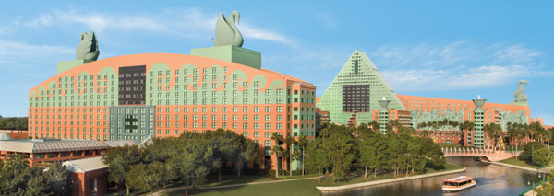
Jr beta national convention held at the swan and dolphin resort in disney world
1500 Epcot Resorts Blvd, Orlando, FL 32830
407-934-4000

Slide 3
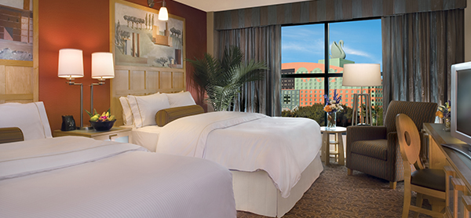
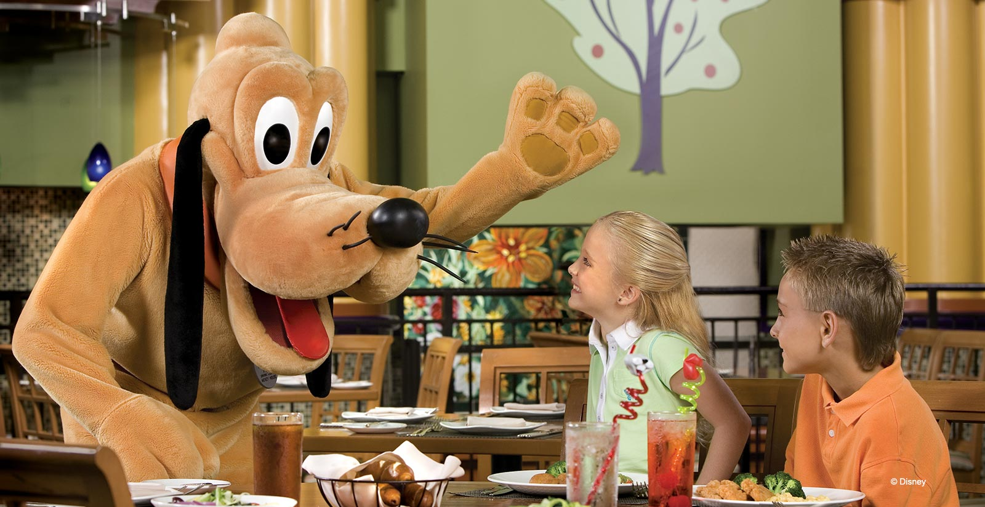
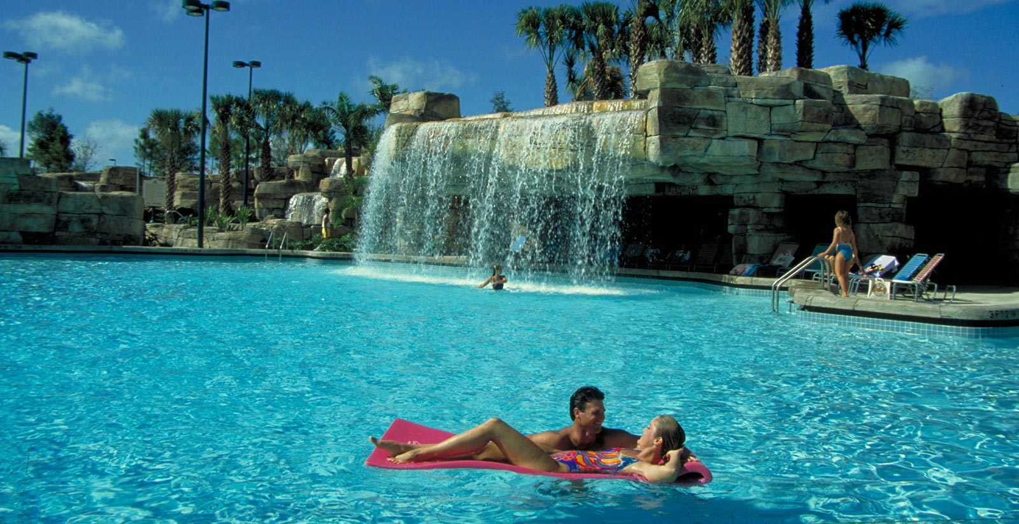
The swan and dolphin resort BENEFITS
Double Bed occupancy
Character dining experience
pools
Will allow up to 5 people per room with a $25 roll away cart fee added per night
A unique dining EXPERIENCE in selected hotel restaurants with appearances by some of the famous celebrities of Walt Disney World.
One of five onsite pools available

Slide 4
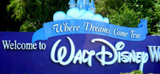
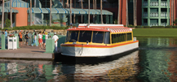
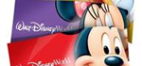
The swan and dolphin resort BENEFITS
EXTRA PARK HOURS BENEFIT
COMPLIMENTARY SCHEDULED TRANSPORTATION
ADVANCE DISNEY TICKETS
Each day one of the four Disney Theme Parks opens an hour early or stays open up to an extra two hours after regular closing for you to enjoy select attractions. This benefit is exclusive to Disney Resort guests only.
The buses and Friendship boats arrive at THE hotel approximately every 20 – 25 minutes so you can come and go as you please with very little wait time.
You can place your order online and pick up your tickets at the resort’s Disney Planning Center will call desk located in either lobby at the resort, any will call window located at Disney theme parks.

Slide 5
OTHER SPECIAL BENEFITS FOR GUEST RESIDING AT THE DISNEY RESORT
COMPLIMENTARY DELIVERY OF PURCHASES MADE IN DISNEY THEME PARKS
COMPLIMENTARY PARKING AT DISNEY THEME PARKS
COMPLIMENTARY SHUTTLE TO ORLANDO VINELAND PREMIUM OUTLETS
ADVANCE TEE TIMES
FASTPASS+

Slide 6
Estimated budget
BETA REGISTRATION | $25 *4 = $100
HOTEL FOR 6 NIGHTS | $1208.28
TOTAL FOR FAMILY OF 4* | $1308.28
Nonrefundable deposit of $100 is due by december 15th, 2016.
The rest of the balance will be split up into 4 payments due on : January 17th, february 15th, march 15th, with the final payment due by april 17th, 2017.
This is based upon total of 136 individuals and may be adjusted as necessary
* Excludes gas, parking fees, tolls, Disney tickets & food

Slide 7
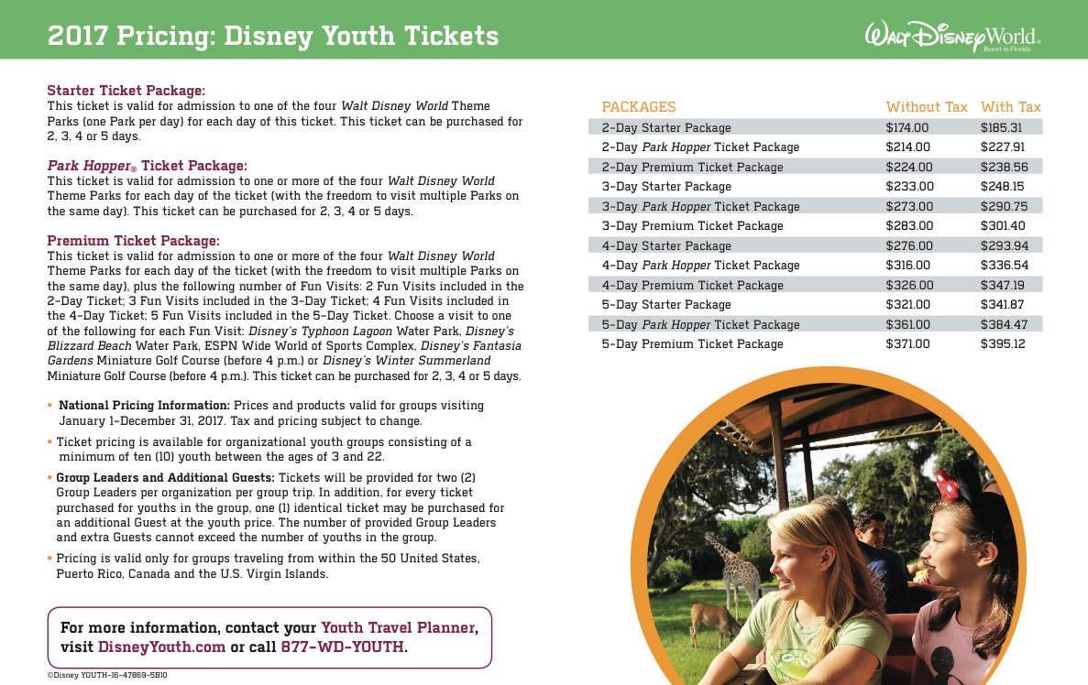
Jr beta national convention

Slide 10
National exhibitions
Reimagine*recreate*recycle– Team of 5 students will create wearable costumes in the style of their favorite disney character using recyclable materials to be showcased on the runway.
Site up – Teams of 4 students will create a high-quality, well designed, original website given a particular scenario
Convention invention--- teams of 4 students will be posed with a situational problem. Utilizing lego products, the team will develop an innovative solution and share with others.

Slide 11



Community service

Slide 12
Community service ideas continued
Tutor little kids
Donate books to shelters
Confidence booster seminars for young kids
School dance and proceeds go to a homeless shelter
Clean the school day
Coat drive
Help to build homes
Visit kids in the hospital and take them stuffed animals/toys
Make cards for Veterans
Paint pictures to beautify the school
Cook for the homeless
Sing Christmas Carols to senior citizens
Donate hygiene products to those less fortunate
Make bird houses
Shoe drive donations
Going to volunteer at a soup kitchen
Create the hang out spot at LCP
Create a school mural
Beautify the Latin Lounge

Slide 13
Community service ideas
Trash pickup
Study hall for those who have C’s
Feed the homeless
Can Food drive
Helping teachers organize or plan class lessons
Volunteer at a store
Watering plants around the school
Sewing clothes for those without them
Dog walking service
Clothing drive
Volunteering at a nursing home
Toy drive for a charity
Plant a garden
Cleaning the park
Reading to the grammar school kids
Volunteer at animal shelter
Volunteer at a daycare center
Paint the rails at school
Visit 5th graders from different schools and inform them of middle school expectations
Make books and give them to grammar school kids
Anti-bullying Pep Rally Program

Slide 14
??? Questions ???

